Slide 1
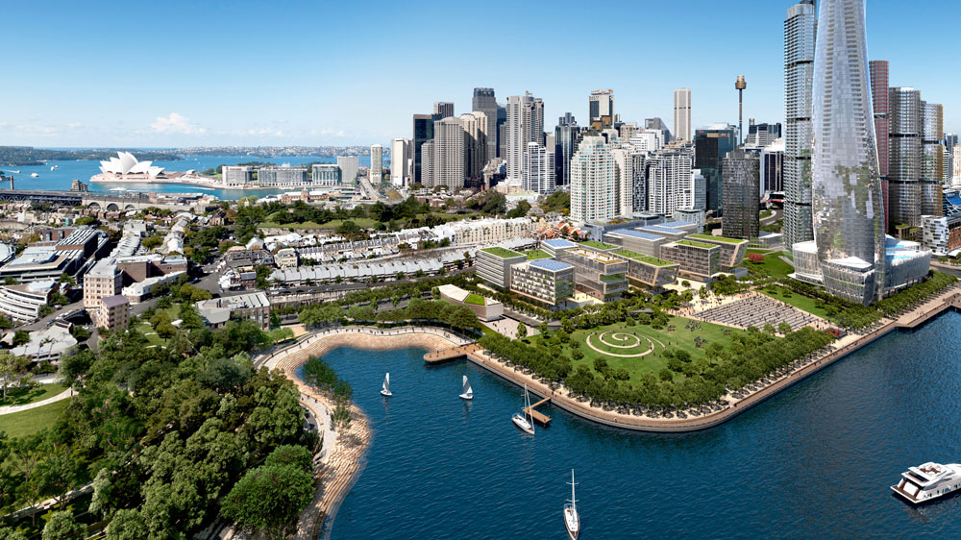
Urban Renewal Planning
Executive Summary
By Soe Htet

Slide 2
Overview
Over the last decade, technology has become an essential part of people’s daily life and enormous information of digital footprint has been generated regarding spending patterns, income, household demographics and many other things. Consequently, town planners have been given valuable access to wealth of data which can be used to gain crucial insights to assist in community redevelopment efforts.
Objective
The objective of this study is to analyse the particulars and financial survey data of 1000 participants, present insights on resident’s wage, spending trends, overall financial health and joviality of the population and use these insights to assist city revitalization plan and allocate city renewal funds.

Slide 3
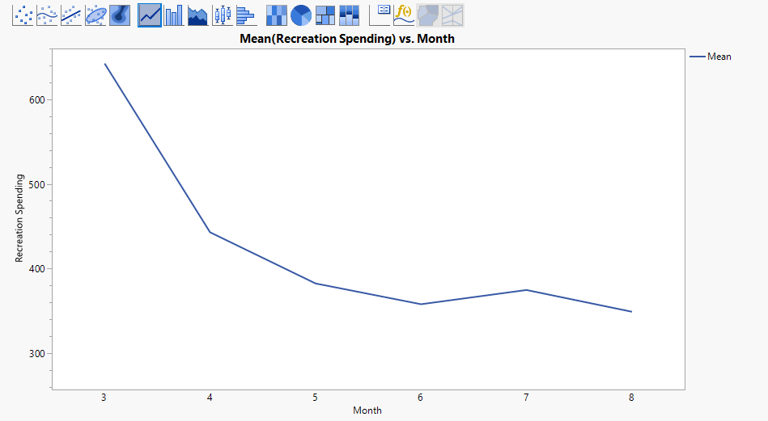
Our residents are cutting down on recreational spending
Recreational spending has a clear downward trend from month 3 to month 8
Month 3 and month 4 has seen a sharp drop in recreational spending. Afterwards, it has decreased more gradually until month 8.

Slide 4
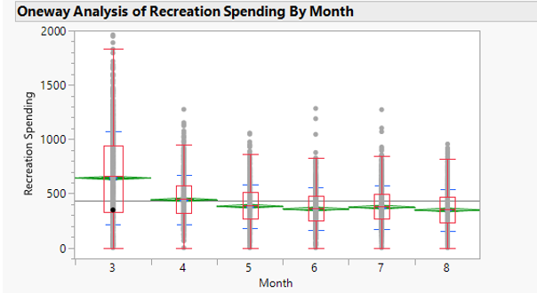
Box plot comparison of monthly recreational spending shows clear difference in means and median values
To confirm with statistical test, nonparametric means comparison tests using Wilcoxon method was performed
Test results show there is statistically significant difference between the means of month 3 and 4 with other months.
However, for other comparisons especially month 7 and 8, p value is greater than alpha value of 0.05, and therefore, null hypothesis that states there is no difference among the means holds and cannot be rejected

Slide 5
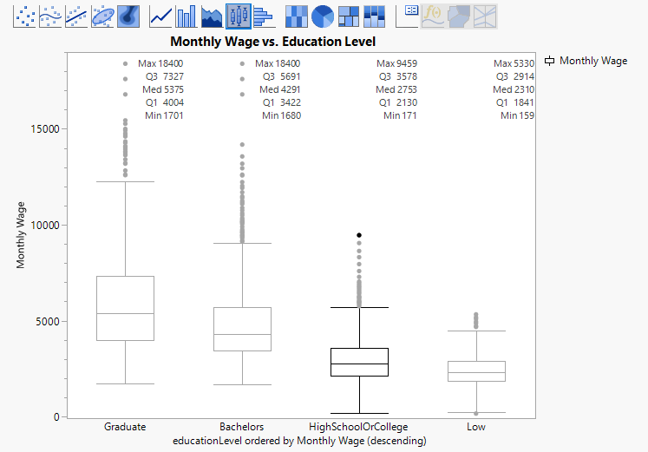
Higher education greatly correlates to increase in income
Residents with higher education level are drawing higher monthly wage as shown in the figure.
Biggest increase in median monthly income is between bachelors and high school / college categories with bachelors’ holders drawing nearly 55% more than the latter.

Slide 6
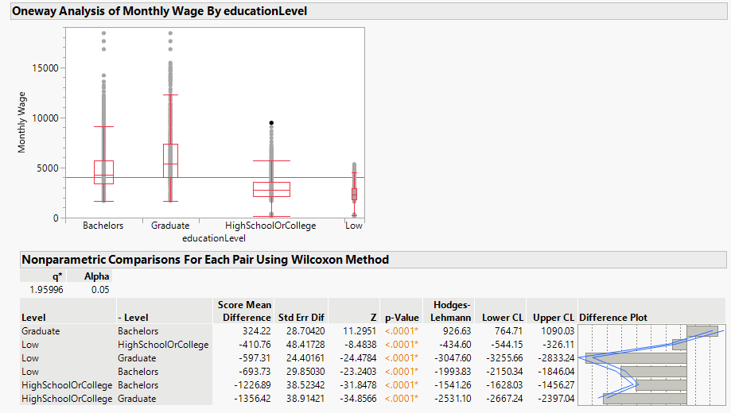
From normality assumption test of month wage data, there is statistical evidence to reject the null hypothesis as the distribution does not conform to normal distribution.
Thus, nonparametric comparison tests are performed. The results show that p-values are lower than significance level. In fact, p-values are less than 0.0001. Hence, we can conclude that the differences in means of the observed distributions are not equal to zero
Renewal funds can further support higher education of residents through subsidies and scholarships and create a talented workforce with thriving economy

Slide 7
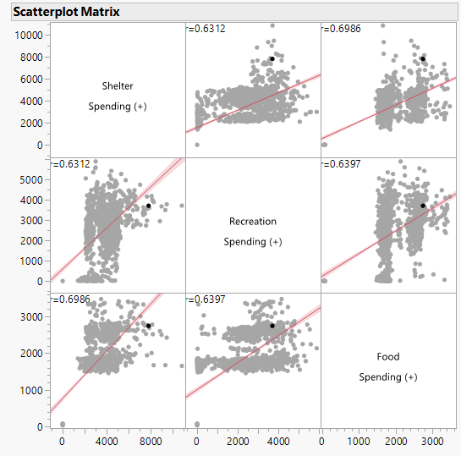
Participants spending big on food also have high spending on shelter and recreation.
As our scatterplot matrix shows, there is moderately strong correlations between spendings on food, shelter and recreation.
It can be an insight to be considered when planning for new infrastructure, for example, to develop shopping centres, eateries and entertainment areas closely together.

Slide 8
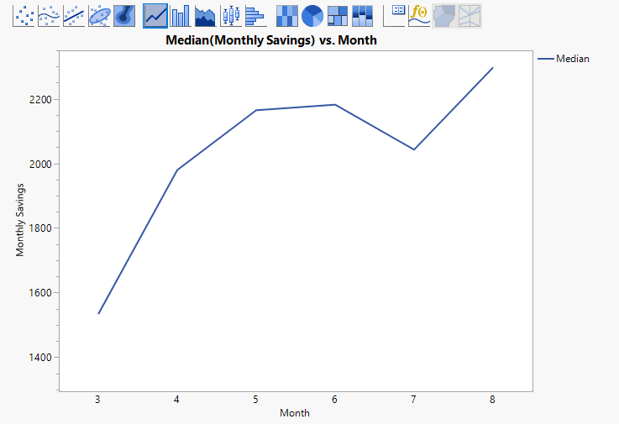
City population is in great financial shape!
During the survey period of 6 months, monthly savings have seen significant growth.
That implies that monthly income of residents are growing quicker than overall cost of living in the city.
That is an indication of healthy job market and thriving economy.

Slide 9
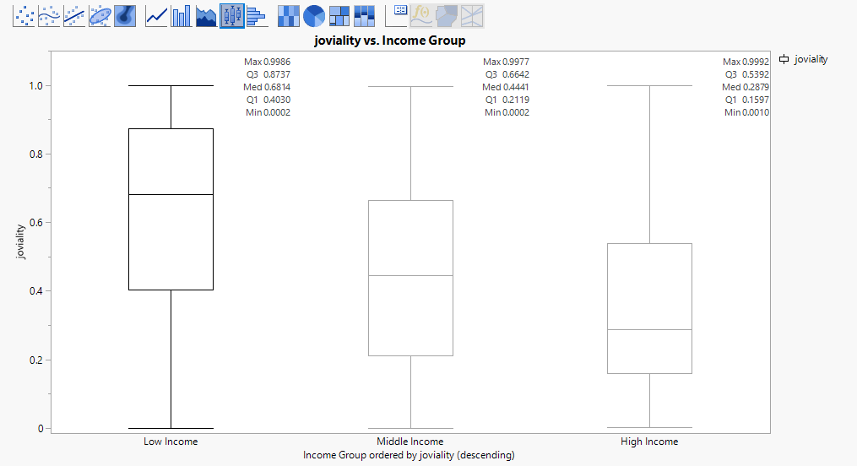
High income individuals reported lower joviality in life
Participants are grouped according to their monthly income with highest and lowest 25% belonging to high income and low income group and the remaining belonging to middle income group.
Surprisingly, joviality score is found to be inversely proportional to income level.

Slide 10
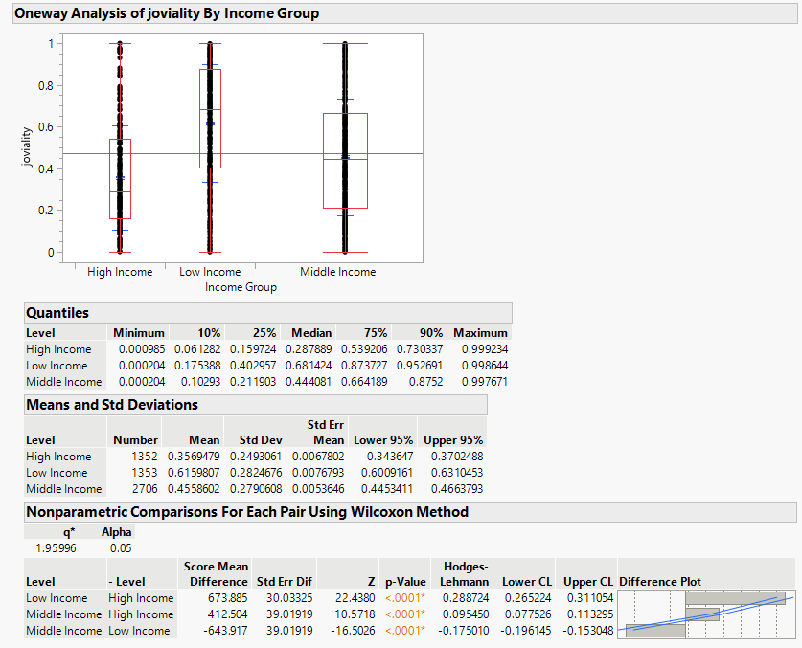
Hypothesis test results indicate that null hypothesis can be rejected due to statistical evidence shown by p-value of less than 0.05.
Thus, there are statistical differences between the means of joviality by income groups.
During the allocation of city renewal funds, the council may consider to fund mental health workshops to better educate the population and help them deal with stress and pressure.

Slide 11
Recommendations
Household size data in the survey is only up to 3-person household. More data can be collected to include bigger household sizes for more complete demographic analysis.
Employment status of survey participants should be collected to better assess the state of current job market in the city.
Appropriate cluster analysis techniques can be used in future studies to form clusters of the population and analyse similar patterns or trends among the clusters.
In future surveys, we should collect opinions of participants on which facilities or infrastructure are due for a major upgrade. This data would be useful to carry out further analysis to assist in infrastructure upgrading plans.

